Slide 1
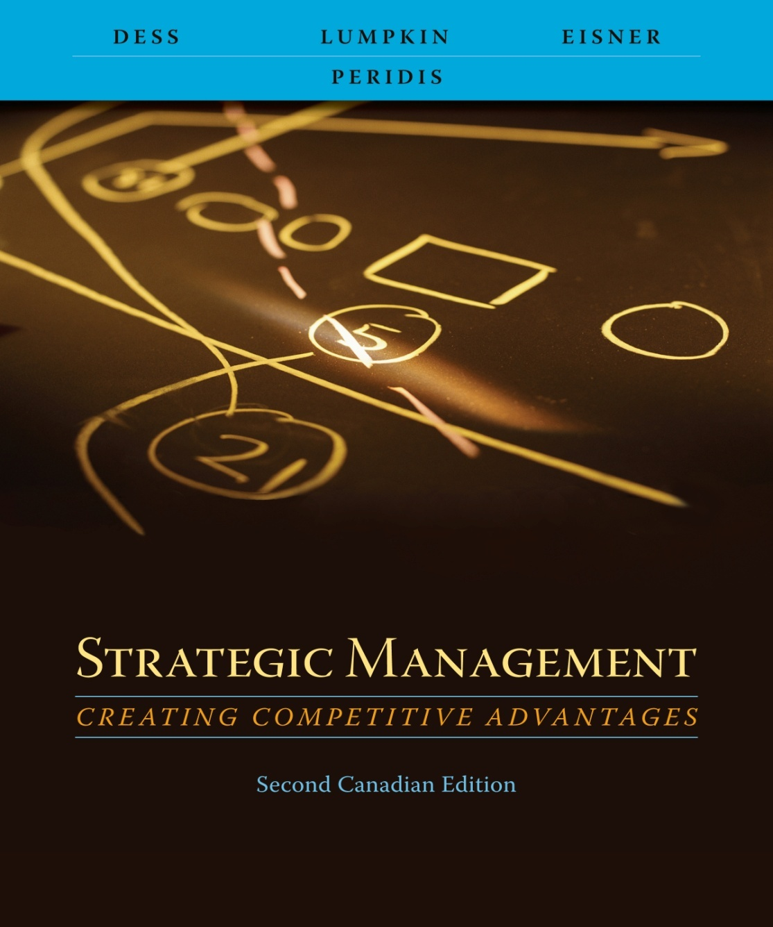
Chapter 5
Business Level Strategy: Creating and Sustaining Competitive Advantages

Slide 2
Learning Objectives
After reading this chapter, you should have a good understanding of:
  The central role of competitive advantage in the study of strategic management.
  The two generic strategy choices: market focus and cost leadership or differentiation.
  How the successful attainment of generic strategies can improve a firm’s relative power vis-à-vis the five forces that determine an industry’s average profitability.
  The pitfalls managers must avoid in striving to attain generic strategies.
  How firms can succeed by developing unique strategies that combine elements of generic strategies
  6. The importance of considering the industry life cycle to determine a firm’s business-level strategy and its relative emphasis on functional area strategies and value-creating activities.

Slide 3
Types of Competitive Advantage and Sustainability
Generic strategies to overcome the five forces and achieve competitive advantage
  Overall cost leadership
    Low-cost-position relative to a firm’s peers
    Manage relationships throughout the entire value chain
  Differentiation
    Create products and/or services that are unique and valued
    Non-price attributes for which customers will pay a premium
  Focus strategy
    Narrow product lines, buyer segments, or targeted geographic markets
    Cost forces
    Differentiation forces

Slide 4
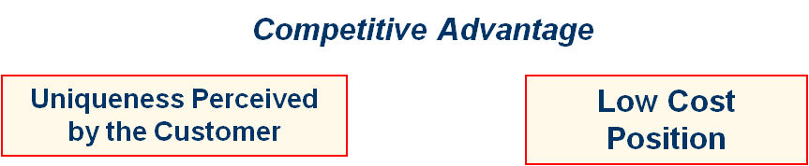
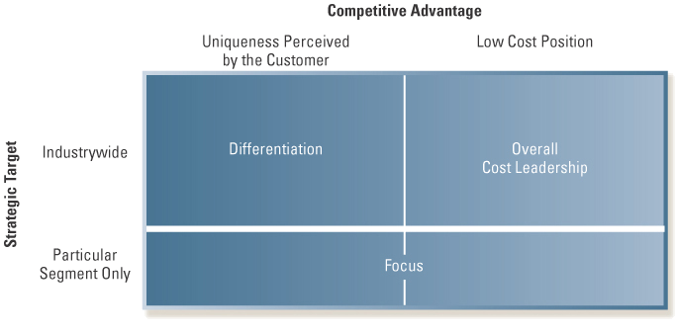
Generic Strategies
Industry-wide
Strategic Target
Particular Segment Only
Exhibit 5.1 Generic Strategies
Source: Reprinted with permission of The Free Press, a division of Simon & Schuster, Inc., from Competitive Strategy: Techniques for Analyzing Industries and Competitors by Michael E. Porter. Copyright © 1980, 1998 by The Free Press.

Slide 5
Overall Cost Leadership
Integrated tactics
  Aggressive construction of efficient-scale facilities
  Vigorous pursuit of cost reductions from experience
  Tight cost and overhead control
  Avoidance of marginal customer accounts
  Cost minimization in all activities in the firm’s value chain, such as R&D, service, sales force, and advertising

Slide 6
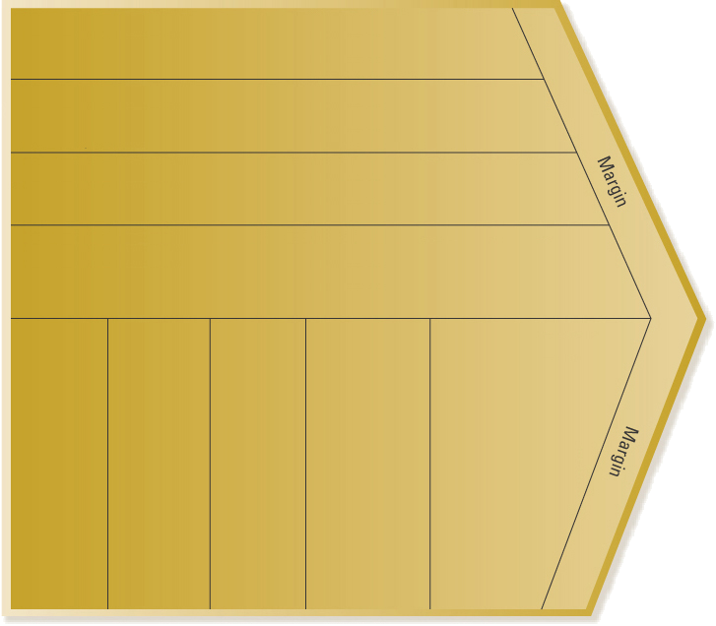
Value-Chain Activities
Firm infrastructure
Few management layers to reduce overhead costs
Standardized account- ing practices to minimize personnel required
Human resource management
Minimize costs associated with employee turnover through effective policies
Effective orientation and training programs to maxi- mize employee productivity
Technology development
Effective use of automated technology to reduce scrappage rates
Expertise in process engineering to reduce manufacturing costs
Effective policy guidelines to ensure low cost raw materials (with acceptable quality levels)
Shared purchasing operations with other business units
Procurement
Effective layout of receiving dock operation
Effective use of quality control inspectors to minimize rework on the final product
Effective utilization of delivery fleets
Purchase of media in large blocks
Sales force utilization is maximized by territory management
Thorough service repair guidelines to minimize repeat maintenance calls
Use of single type of repair vehicle to minimize costs
Inbound logistics
Operations
Outbound logistics
Marketing and sales
Service
Exhibit 5.3 Value-Chain Activities: Examples of Overall Cost Leadership
Source: Adapted with the permission of The Free Press, a division of Simon & Schuster,
Inc., from Competitive Advantage: Creating and Sustaining Superior
Performance by Michael E. Porter. Copyright © 1985 by Michael E. Porter.

Slide 7
Overall Cost Leadership (Cont.)
A firm following an overall cost leadership position
  Must attain parity on the basis of differentiation relative to competitors
  Parity on the basis of differentiation
    Permits a cost leader to translate cost advantages directly into higher profits than competitors
    Allows firm to earn above-average profits

Slide 8
Overall Cost Leadership:
Improving Competitive Position vis-à-vis the Five Forces
An overall low-cost position
  Protects a firm against rivalry from competitors
  Protects a firm against powerful buyers
  Provides more flexibility to cope with demands from powerful suppliers for input cost increases
  Provides substantial entry barriers from economies of scale and cost advantages
  Puts the firm in a favorable position with respect to substitute products

Slide 9
Pitfalls of Overall
Cost Leadership Strategies
Too much focus on one or a few value-chain activities
All rivals share a common input or raw material
The strategy is initiated too easily
A lack of parity on differentiation
Erosion of cost advantages when the pricing information available to customers increases

Slide 10
Differentiation
Differentiation can take many forms
  Prestige or brand image
  Technology
  Innovation
  Features
  Customer service
  Dealer network

Slide 11
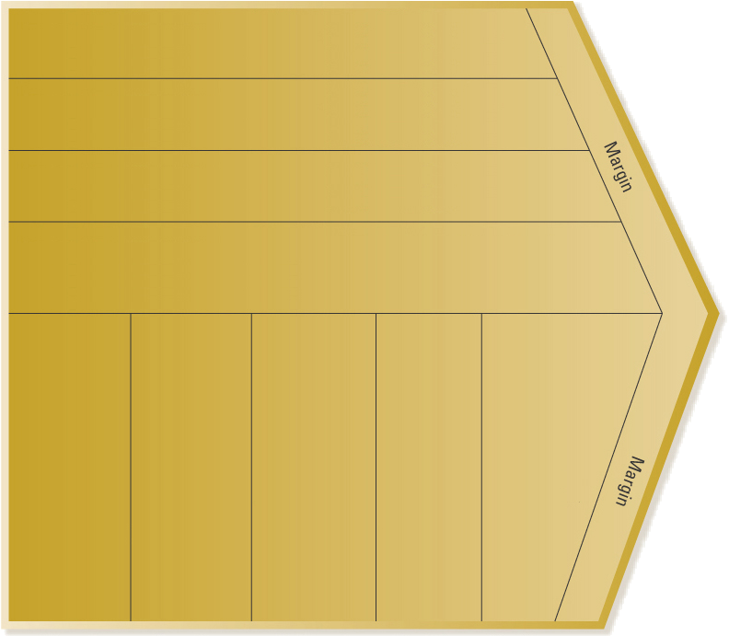
Value-Chain Activities: Examples of Differentiation
Firm infrastructure
Superior MIS—To integrate value-creating activities to improve quality
Facilities that promote firm image
Widely respected CEO enhances firm reputation
Human resource management
Programs to attract talented engineers and scientists
Provide training and incentives to ensure a strong customer service orientation
Technology development
Superior material handling and sorting technology
Excellent applications engineering support
Procurement
Purchase of high-quality components to enhance product image
Use of most prestigious outlets
Superior material handling operations to minimize damage
Quick transfer of inputs to manufactur- ing process
Flexibility and speed in responding to changes in manu-facturing specs
Low defect rates to improve quality
Accurate and responsive order processing
Effective product replenish-ment to reduce customer’s inventory
Creative and innovative advertising programs
Fostering of personal relation-ship with key customers
Rapid response to customer service requests
Complete inventory of replacement parts and supplies
Inbound logistics
Operations
Outbound logistics
Marketing and sales
Service
Exhibit 5.5 Value-Chain Activities: Examples of Differentiation
Source: Adapted with the permission of The Free Press, a division of Simon & Schuster, Inc., from Competitive Advantage: Creating and Sustaining Superior Performance by Michael E. Porter. Copyright © 1985 by Michael E. Porter.

Slide 12
Differentiation cont’d
Firms may differentiate along several dimensions at once
Firms achieve and sustain differentiation and above-average profits when price premiums exceed extra costs of being unique
Successful differentiation requires integration with all parts of a firm’s value chain
An important aspect of differentiation is speed or quick response

Slide 13
Differentiation: Improving Competitive Position vis-à-vis the Five Forces
Differentiation
  Creates higher entry barriers due to customer loyalty
  Provides higher margins that enable the firm to deal with supplier power
  Reduces buyer power because buyers lack suitable alternative
  Reduces supplier power due to prestige associated with supplying to highly differentiated products
  Establishes customer loyalty and hence less threat from substitutes

Slide 14
Potential Pitfalls of
Differentiation Strategies
Uniqueness that is not valuable
Too much differentiation
Too high a price premium
Differentiation that is easily imitated
Dilution of brand identification through product-line extensions
Perceptions of differentiation may vary between buyers and sellers

Slide 15
Focus
Focus is based on the choice of a narrow competitive scope within an industry
  Firm selects a segment or group of segments (niche) and tailors its strategy to serve them
  Firm achieves competitive advantages by dedicating itself to these segments exclusively
Two variants
  Cost focus
  Differentiation focus

Slide 16
Focus: Improving Competitive Position vis-à-vis the Five Forces
Focus
  Creates barriers of either cost leadership or differentiation, or both
  Also focus is used to select niches that are least vulnerable to substitutes or where competitors are weakest

Slide 17
Pitfalls of Focus Strategies
Erosion of cost advantages within the narrow segment
Focused products and services still subject to competition from new entrants and from imitation
Focusers can become too focused to satisfy buyer needs

Slide 18
Combination Strategies: Integrating Overall Low Cost and Differentiation
Primary benefit of successful integration of low-cost and differentiation strategies is difficulty it poses for competitors to duplicate or imitate strategy
Goal of combination strategy is to provide unique value in an efficient manner

Slide 19
Three Combination Approaches
Automated and flexible manufacturing systems
Exploiting the profit pool concept for competitive advantage
Coordinating the “extended” value chain by way of information technology

Slide 20
Combination Strategies: Improving Competitive Position vis-à-vis the Five Forces
Firms that successfully integrate differentiation and cost strategies obtain advantages of competition from both approaches
  High entry barriers
  Bargaining power over suppliers
  Reduces power of buyers (fewer competitors)
  Value position reduces threat from substitute products
  Reduces the possibility of head-to-head rivalry

Slide 21
Pitfalls of Combination Strategies
Firms that fail to attain both strategies may end up with neither and become “stuck in the middle”
Underestimating the challenges and expenses associated with coordinating value-creating activities in the extended value chain
Miscalculating sources of revenue and profit pools in the firm’s industry

Slide 22
Industry Life-Cycle States:
Strategic Implications
Life cycle of an industry
  Introduction
  Growth
  Maturity
  Decline
Emphasis on strategies, functional areas, value-creating activities, and overall objectives varies over the course of an industry life cycle

Slide 23
Strategies in the Introduction Stage
Products are unfamiliar to consumers
Market segments not well defined
Product features not clearly specified
Competition tends to be limited
Strategies
  Develop product and get users to try it
  Generate exposure so product becomes “standard”

Slide 24
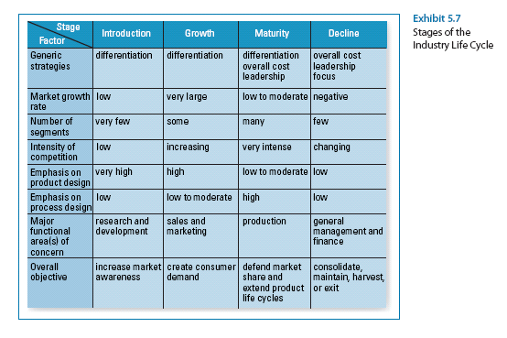
Stages of Industry Life Cycle

Slide 25
Strategies in the Growth Stage
Characterized by strong increases in sales
Attractive to potential competitors
Primary key to success is to build consumer preferences for specific brands
Strategies
  Brand recognition
  Differentiated products
  Financial resources to support value-chain activities

Slide 26
Strategies in the Maturity Stage
Aggregate industry demand slows
Market becomes saturated, few new adopters
Direct competition becomes predominant
Marginal competitors begin to exit
Strategies
  Efficient manufacturing operations and process engineering
  Low costs (customers become price sensitive)

Slide 27
Strategies in the Decline Stage
Industry sales and profits begin to fall
Strategic options become dependent on the actions of rivals
Strategies
  Maintaining
  Exiting the market
  Harvesting
  Consolidation

Slide 28
Turnaround Strategies in the Life Cycle
Asset and cost surgery
Selective product and market pruning
Piecemeal productivity improvements

